Slide 1
The Under Armour Keystone Classic!
Blaine King
&
Trever Sheets

Slide 2
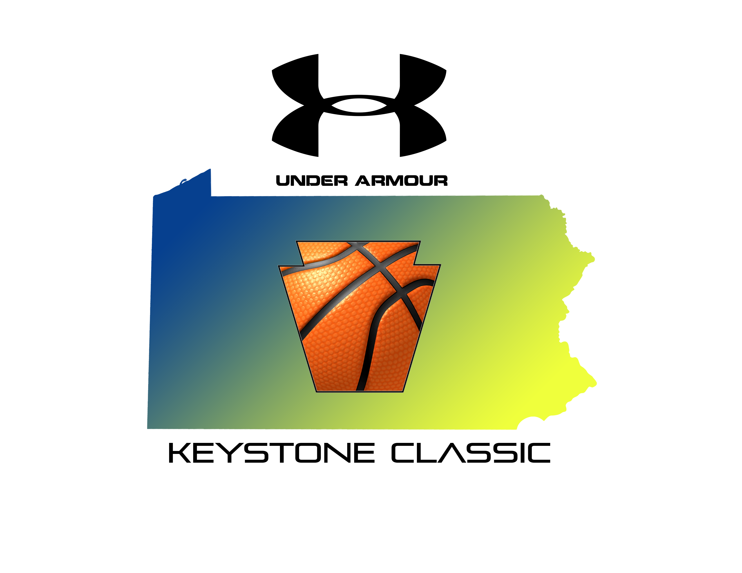
The Under Armour Keystone Classic

Slide 3
What is the Keystone Classic you ask?
The Keystone Classic is a 5 day College Basketball Tournament that will happen at the start of the College Basketball Season.
It will feature the top 12 College Basketball Universities/Colleges (Depending on ranking) in the State of Pennsylvania.

Slide 4
Tournament Layout
The 5 day tournament will be split up into 2 regions; East and West. Depending on the college location that is how we will determine which region that will be in.
The Tournament will begin on Tuesday and will run all the way through Saturday when the championship will be played.
  Tuesday: Opening Round
  Wednesday: Second Round
  Thursday: Travel Day
  Friday: Semi-Finals
  Saturday: Finals

Slide 5
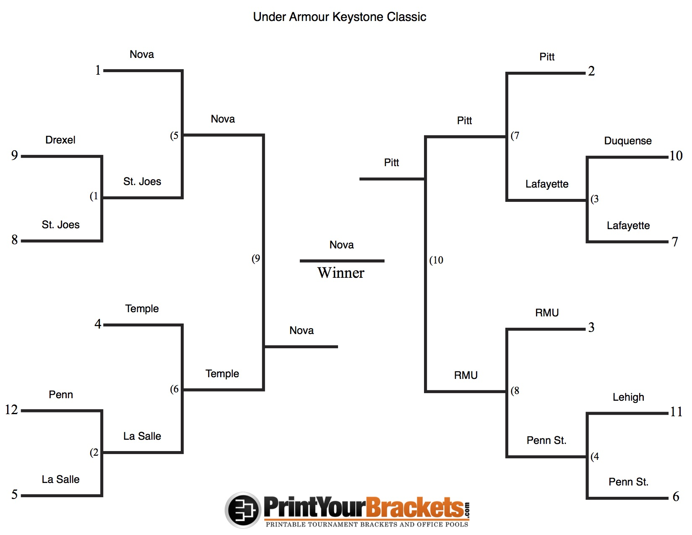

Slide 6

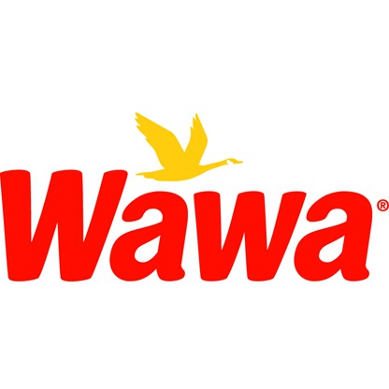

Sponsorship/Naming Rights Deal
There will be 3 type of Sponsors for the Keystone Classic.
Wawa will represent the Eastern Side of the Bracket and Sheetz will represent the Western Side.
The National Sponsor will be Under Armour as they have a naming rights deal with us too for the Keystone Classic.

Slide 7
Market Segmentation
We are trying to target multiple audiences for the Keystone Classic.
  Sports Fans
  Basketball Fans
  Males between the ages of 10-60
  Pennsylvania Residence
  Men/Women between the ages of 16-

Slide 8
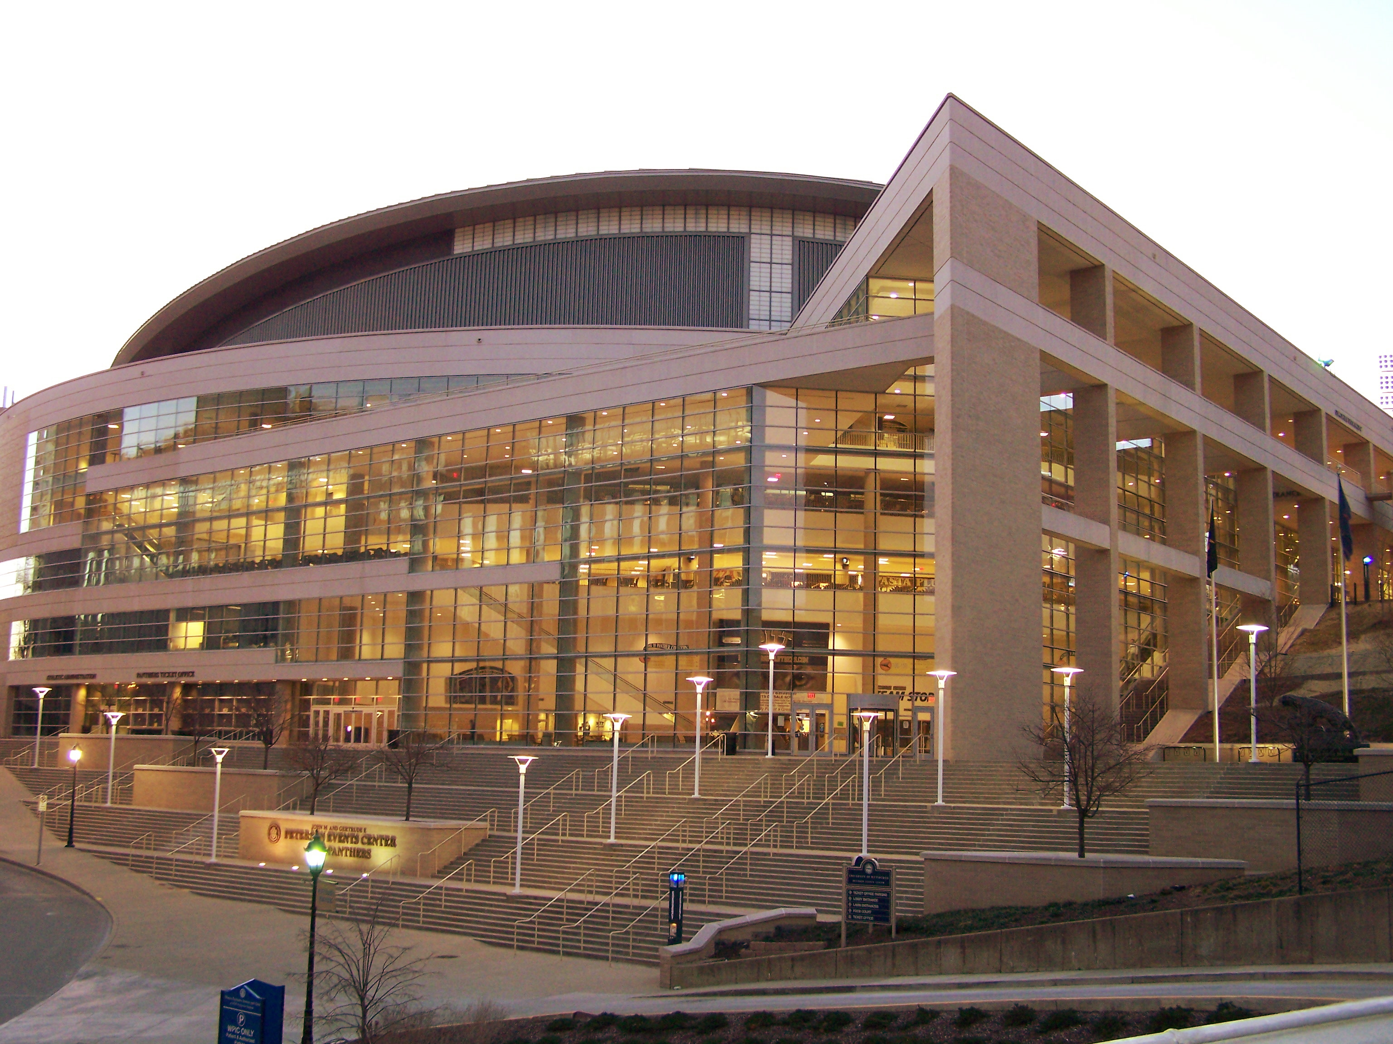
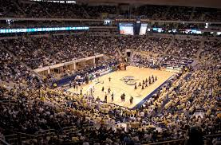
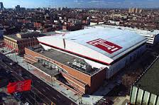
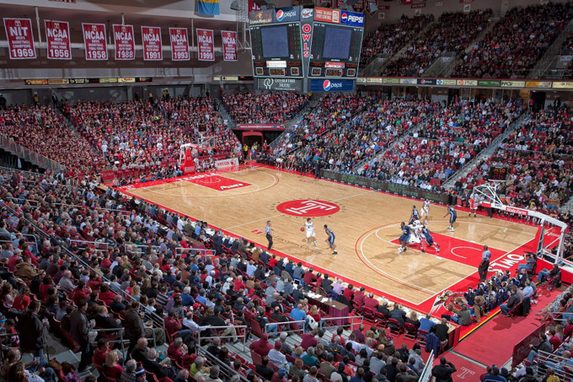
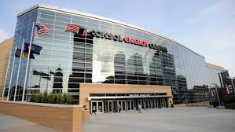
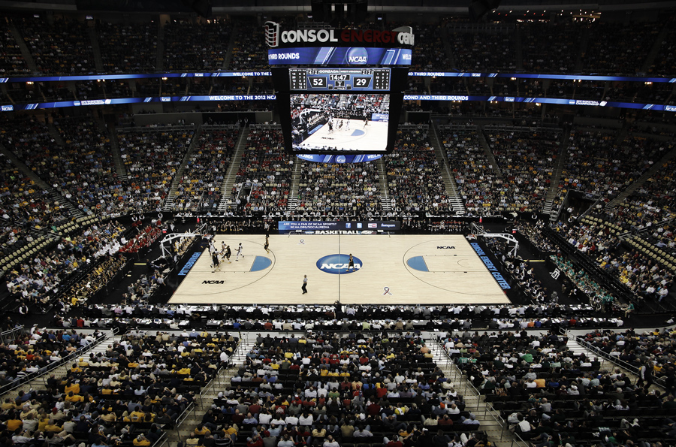
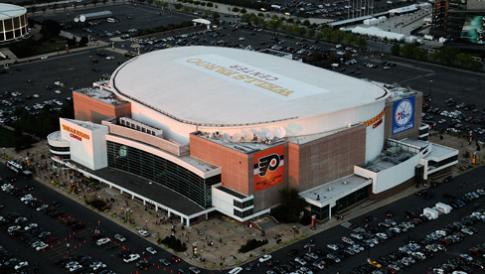
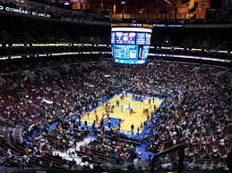
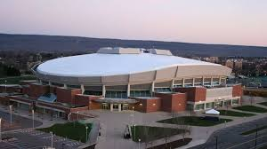

Location
The Keystone Classic will take place in Pennsylvania.
The Eastern Bracket Opening Round and 2nd Round will take place in Philadelphia at the Wells Fargo Center and the Liacouras Center.
The Western Bracket Opening Round and 2nd Round will take place in Pittsburgh at Consol Energy Center and The Petersen Events Center.
The Semi-Final and Finals will take place at the Bryce Jordan Center at Penn State.

Slide 9



National Broadcast
We have Partnered with Fox Sports to be our national broadcast partner for the tournament.
During the Keystone Classic, games will appear on Fox, Fox Sports 1, and Fox Sports 2.
    Fox Sports 1 and Fox Sports 2 will carry the opening round games and the 2nd round games
    Fox Sports 1 will carry the Semi-Finals and pre-finals festivities
    Fox will carry the finals

Slide 10
Endorsement/Licensing
We have Sheetz, Wawa as our sponsors and Under Armour as our Naming right deal.
Other Endorsers will be the colleges and Universities themselves to promote themselves.
We will also have the respective teams have current and former players/coaches as endorsers.
The NCAA will License The Keystone Classic

Slide 11


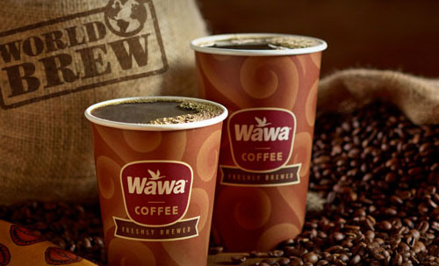
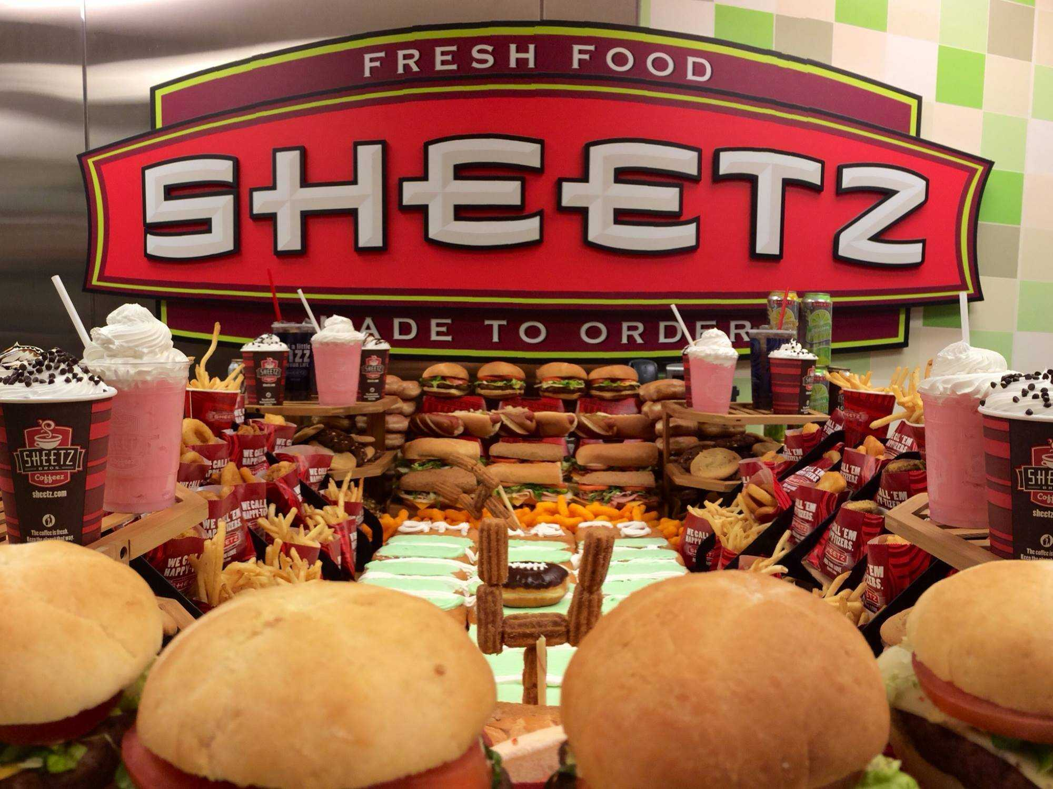
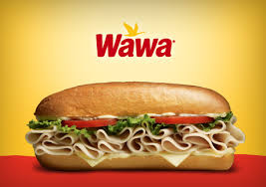
Fan Attraction
Throughout the Keystone Classic there will be a number of activities happening that will get the fans involved.
There will be a three point contest between fans representing each of the teams in the Key Stone Classic; If you win you advance to the next round as if you were also apart of the Keystone Classic.
There will also be a Coffee/Sandwich race between a fan representing each team. This race will be Sponsored by Wawa and Sheetz to finally answer the question of who has the best coffee and food.

Slide 12
More Fan Attraction
There will also be other games that will happen before the finals.
The first game will be a consolation game between the losers of the Semi-Final games that will count as a win for the winning team but not as a loss for the losing team.
The second game will be an all star game between the best high school basketball players from the Eastern and Western sides of Pennsylvania.

